Slide 1
ETRSS-1 Shock Test Training
DFH SATELLITE CO.,LTD
February.2019

Slide 2
Part I: Introduction of satellite shock environment
Part II: Satellite Shock Test introduction

Slide 3
Part I: Introduction of satellite shock environment
Course Introduction
Shock test post responsibility
Post input and output documents
Satellite shock environment introduction

Slide 4
1. Course Introduction
Teacher Introduction
Subject: Satellite Shock Test (test plan and test summary)
Discipline

Slide 5
2. post responsibility
Satellite shock test plan and summary
Shock test implementation technical coordinate
Unit shock test condition

Slide 6
3. Input and Output documents
Input documents
Standards
CASTSS-E-106 Requirements for mechanical environment test for spacecraft products
CASTSS-Q-56 Safety provisions of satellite -environmental test
CASTSS-E-40 General technical requirements for hoisting, turning, parking and transportation for satellite
Documents
Technical network for satellite development
Design report for satellite configuration and layout
Technical Requirements to launching vehicle for satellite

Slide 7
3. Input and Output documents
Output documents
satellite-launching vehicle clamp bond unlock test plan
satellite-launching vehicle clamp bond unlock test summary

Slide 8
4.Satellite shock environment introduction
4.1 Shock resource, characteristic, effect
Source
the high frequency transient responses of spacecraft structures are due primarily to the activation of pyrotechnic (explosive) devices.
Characteristic
Duration short
High frequency to 100kHz
Big acceleration 5,000g or above

Slide 9
Introduction of satellite shock environment
effect
Transients, commonly referred to as pyro shock, produce little low frequency energy;
Pose no significant damage threat to the basic spacecraft structure beyond that localized damage scope the pyrotechnic device is intended to produce.
The primary design concerns associated with pyro shock involve the equipment items that are mounted on the spacecraft structure.

Slide 10
Specifically, for equipment items that have a first natural frequency below 500 Hz, the predicted responses of the equipment structure will generally correspond to stresses well below those needed to cause a failure, even though small elements in the equipment with resonance frequencies above 1 kHz may fail.
The primary threat posed by pyro shock is to small elements, primarily in optical and electronic equipment, that are composed of brittle materials such as glass or ceramics.
Pyro shock have also been known to cause malfunctions of surface mounted elements on electronic circuit boards and computer memory elements.

Slide 11
A few important general design guidelines that have evolved from experience are as follows:
Always mount equipment that is sensitive to high frequency excitations, particularly optical and electronic equipment, as far away as feasible from pyrotechnic devices.
Avoid locating sensitive equipment on structures that provide a good transmission path for high frequency energy, for example, honeycomb structures.
Attempt to locate sensitive equipment on structures that are separated from pyrotechnic devices by structural joints and/or discontinuities.
When feasible, avoid hard-mounting elements composed of brittle materials to the basic structure of the equipment.

Slide 12
In summary, the main defense against pyro shock induced flight failures is the careful testing with an appropriate margin of individual equipment items using one of the laboratory simulation procedures, and in particular, a full pre-flight system test in the laboratory where all pyrotechnic devices are activated in sequence or in combination, as will occur in flight.

Slide 13
4.2 definition
Shock Response Spectrum(SRS)
The shock response spectrum (also called a shock spectrum, response spectrum, or SRS) has been traditionally used as a measure of the damaging potential of a given transient environment, either deterministic or random.

Slide 14
Shock Response Spectrum(SRS)
The concept of the SRS involves a hypothetical single degree-of-freedom system (oscillator) consisting of a mass supported by a spring and a dashpot, both attached to a rigid base.
The SRS, denoted by Sx(fn,ζ), for a transient acceleration signal a(t) is commonly defined as the largest peak acceleration response of the mass of the oscillator with undamped natural frequency fn and damping ratio ζ when the transient acceleration a(t) is applied at the base of the oscillator.

Slide 15
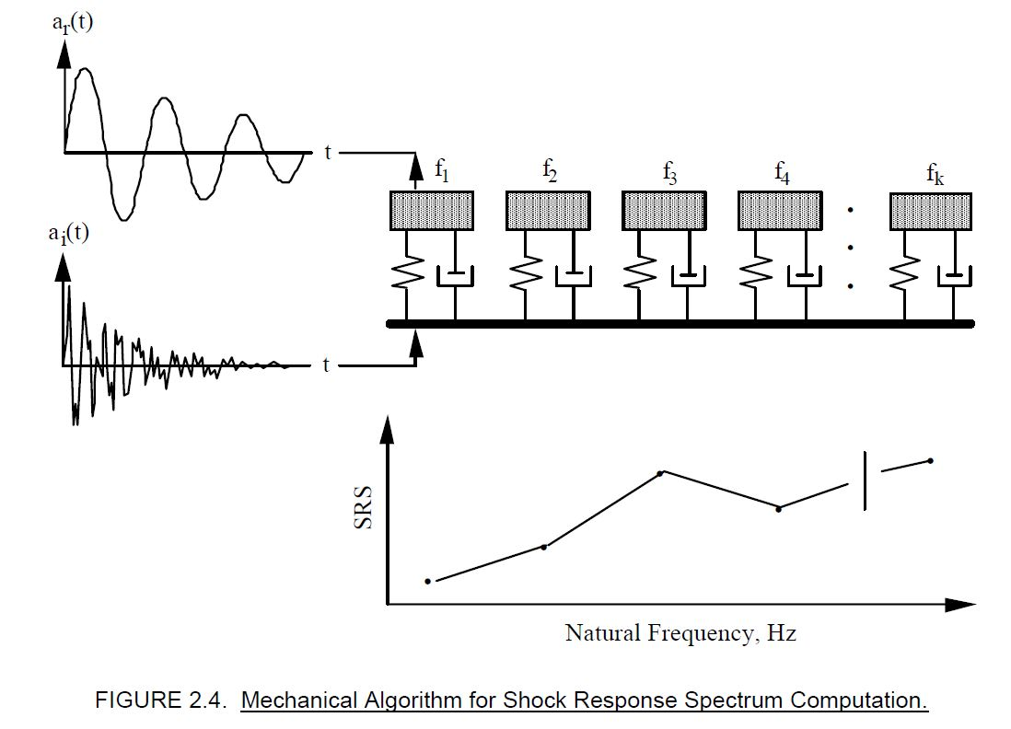

Slide 16
4.3 Shock environment simulation methods
pyro technics deployment shock
Tests are conducted by actuation of the flight pyrotechnic devices, which provide shock qualification.
Advantage: the real pyroshock event in its most complex form.
The main objectives of the pyroshock test are:
to define shock response in the vicinity of potentially sensitive equipment so that component test specifications may be derived or verified;
to conduct qualification and thus verify the design values for shock.

Slide 17
pyro technics deployment shock
Disadvantage:
Considerable time and expense are required to obtain all the required hardware.
The hardware must then be assembled, instrumented, and removed for post-test evaluation. Generally, special facilities are required for the use of explosives.

Slide 18
Shock environment simulation methods
(2) Electrodynamic Shakers
Pyroshock environments can be simulated with an acceleration transient produced on an electrodynamic shaker.
In this method the acceleration transient is synthesized so that its shock response spectrum closely matches the test requirement.With this method a relatively complex SRS shape can be matched within close tolerances up to about 3000 Hz.

Slide 19
Shock environment simulation methods
(2) Electrodynamics Shakers
The equipment limits (maximum acceleration) restrict this method to the simulation of lower energy pyroshock environments.
However, recent developments show moderate success to higher frequencies for very small items.
Even if the desired SRS is precisely met, an overtest is likely due to the high mechanical impedance of the shaker relative to the structure to which the test item is attached in a real application.

Slide 20
Shock environment simulation methods
(3) Other simulation method
Drop table shock machines:
Pulses produce significantly greater velocity change than a pyroshock environment. A severe overtest at low frequencies can be expected if a drop table is used to simulate pyroshock environments.
This can result in failures of structural members that would not have been significantly stressed by the actual pyroshock.

Slide 21
In certain cases, drop tables may produce acceptable pyroshock qualification testing due to common availability and low test cost.
if a test item has significant design margin at low frequencies ;
if the lowest natural frequency of the test item is higher than the overtested low-frequency range, then the low-frequency overtest may be irrelevant since the effect on the test item is dominated by the peak g’s of the acceleration time history.
If a drop table is selected as a means of conducting a pyroshock qualification test, the test item must be subjected to a shock in both positive and negative directions for each axis tested.

Slide 22
4.4 Test Procedure
The detailed test procedure for near-field pyroshock simulations using ordnance test facilities is dependent on the specific design of the facility and local government regulations related to safety. Similarly, the detailed test procedures for mid-field and far-field pyroshock simulations are dependent on the type of facility used.

Slide 23
The general procedure:
Attach the test item to the test machine using an appropriate test fixture and with safety-approved procedures so as to provide the high frequency transient excitation along one of the three orthogonal axes of the test item.
Attach an accelerometer to the test fixture at a location near the input to the test item. For large test items with multiple attachment points, additional accelerometers should be mounted at several of the mounting point locations for the test item to allow the computation of an average input excitation to the test item.
For functional tests power-up the test item to function as it would during the exposure to the transient events being simulated.

Slide 24
Apply the high frequency transient with the wave form or shock response spectrum, plus the margins . Note that some test facilities may require considerable trial-anderror effort using a simulated test item to achieve the specified SRS for the excitation into the test item.
During the test, accomplish the following:
Record the motion time histories measured by the input accelerometers
Monitor or record all relevant functional performance data for the test item.
Compute the SRS for all input accelerometer signals.
After the test, verify that the SRS levels for the input accelerometer, or the average of multiple input accelerometers, agree with the specified SRS level tolerances, with the further requirement that at least half of the SRS values at the various natural frequencies exceed the specified SRS levels.

Slide 25
Assuming no failure occurs, reattach the test item to the test machine using an appropriate test fixture and safety-approved procedures so as to provide the high frequency transient excitation along the second of the three orthogonal axes of the test item, and repeat Steps b ~ g.
Again assuming no failure occurs and three-axis testing is required by the test specification, reattach the test item to the test machine using an appropriate test fixture and safety-approved procedures so as to provide the high frequency transient excitation along the third of the three orthogonal axes of the test item, and repeat Steps b ~ g.

Slide 26
Part II: Satellite Shock Test introduction

Slide 27
Satellite-launching vehicle Clamp bond unlock test introduction
Introduction
Reference documents
Test purpose
Satellite technical status
Test Requirements (meet or not?)
Test flow program and steps
Test process description
Test data analysis and result
Test problem record and suggestion
Test Result

Slide 28
Satellite-launching vehicle Clamp bond unlock test introduction
Introduction
Satellite briefly introduction
According to the arrangement of the satellite’s development technical flow program, the satellite-launching vehicle clamp bond unlock test is required.
The document regulates the test purpose, test status, test flow program, test requirements and so on, which is applicable to the Satellite-launching vehicle clamp bond unlock test.

Slide 29
Satellite-launching vehicle Clamp bond unlock test introduction
Reference documents
Standards
CASTSS-E-106 Requirements for mechanical environment test for spacecraft products
CASTSS-Q-56 Safety provisions of satellite -environmental test
CASTSS-E-40 General technical requirements for hoisting, turning, parking and transportation for satellite
Documents
Technical network for satellite development
Design report for satellite configuration and layout
Technical Requirements to launching vehicle for satellite

Slide 30
Satellite-launching vehicle Clamp bond unlock test introduction
Test purpose
Measure the shock response from satellite-launching vehicle unlock;
Verify the design reliability of satellite-launching vehicle separation system.

Slide 31
Satellite-launching vehicle Clamp bond unlock test introduction
4. Test technical status
(1) Satellite coordinate and quadrant
(2) satellite main parameter
dimension
Mass property parameter of satellite

Slide 32
Satellite-launching vehicle Clamp bond unlock test introduction
Test technical status
(3) Satellite main technical state
All the product on the satellite should be flight module;
The thermal control of the satellite is complete;
Two propellant tanks are not filled with hydrazine fuel, and the tanks are fulfilled with required gas simulating tank pressure during launching;
All vibration sensors have been installed;
The whole satellite is implemented the grounding.

Slide 33
Satellite-launching vehicle Clamp bond unlock test introduction
Test technical status
(4) Launching vehicle main technical state
The main participant equipment includes clamp bond device, adapter for satellite and explosive bolts;
The interface of clamp bond is same as that of the flight product;
Explosive bolts have been equipped with actual pyro technics, and the safety protect measurements have been taken;
The interface test of satellite and launching vehicle have been done;
The pretension device for clamp bond and attached pretension measurement cable are loosen, and the attached part for separation of satellite and launching vehicle have been installed.

Slide 34
Satellite-launching vehicle Clamp bond unlock test introduction
5. Test requirement introduction
5.1 Test field
General requirement
Specific test field and separated;
Enough Space for hoisting, turning, parking and transportation satellite;
Meet the requirement of transportation and work for test equipment and supporter;
Grounding for satellite, test equipment and supporter.
Environmental requirement
Temperature: 10℃～25℃；
Cleanliness: 100,000 level ；
Relative humidity: 30%～60％；
Power supply requirement
Meet the requirement of power supply for test.

Slide 35
Satellite-launching vehicle Clamp bond unlock test introduction
5.2 Test system introduction
Test system includes pyro technics control system, shock response measurement system, high-speed photography system and test support equipment.
pyro technics control system composition
Ground Power supply and cable for pyro technics unlock test, charged by LV
Shock response measurement system composition
Shock accelerator, vibration accelerator and data acquisition system, charged by CAST/511

Slide 36
Satellite-launching vehicle Clamp bond unlock test introduction
Test system introduction
high-speed photography system
Black and white color, record time >6s
test support equipment composition
Support equipment for satellite, hoisting equipment and so on.

Slide 37
Satellite-launching vehicle Clamp bond unlock test introduction
Test system equipment
Controller and control cable (LV);
Power supply for boost-on (LV);
Measurement sensors (Test implementer);
Data acquisition system (Test implementer);
High speed photography system (Test implementer);
Protector shelf.

Slide 38
Satellite-launching vehicle Clamp bond unlock test introduction
5.3 Requirements for sensor distribution
The amount of shock sensors, channels
Installation positions of shock sensors
测点 | 测点位置 | 量程 | 方向
C1 | On the interface surface of satellite to LV , the position corresponding to clamp bond end 1 | 5000g | 3
C2 | On the interface surface of satellite to LV , the position corresponding to clamp bond end 2 | 5000g | 3
C3 | On the interface surface of satellite to LV , the position corresponding to clamp bond end 3 | 5000g | 3
C4 | On the interface surface of propellant cabin and electrical cabin, the position corresponding to clamp bond end 1 | 5000g | 3
C5 | On the interface surface of propellant cabin and electrical cabin, the position corresponding to clamp bond end 2 | 5000g | 3
C6 | On the interface surface of propellant cabin and electrical cabin, the position corresponding to clamp bond end 3 | 5000g | 3

Slide 39
Satellite-launching vehicle Clamp bond unlock test introduction
测点 | 测点位置 | 量程 | 方向
C7 | Position 1 on the bottom panel of electrical cabin of satellite | 5000g | 3
C8 | Position 2 on the bottom panel of electrical cabin of satellite | 5000g | 3
C9 | ……. | 5000g | 3
C10 | Position 1 on the long web of electrical cabin of satellite | 5000g | 3
C11 | Position 2 on the long web of electrical cabin of satellite | 5000g | 3
C12 | ……. | 5000g | 3
C13 | Position on the bottom panel of payload cabin of satellite | 5000g | 3
C14 | Position on the top panel of payload cabin of satellite | 5000g | 3
C15 | …… | 5000g | 3
C16 | On the LV adapter for satellite, the position corresponding to clamp bond end 1 (Assigned by LV) | 5000g | 3
C17 | On the LV adapter for satellite, the position corresponding to clamp bond end 3 (Assigned by LV) | 5000g | 3

Slide 40
Satellite-launching vehicle Clamp bond unlock test introduction
5.4 Requirements for data acquisition and processing
Measurement sensors and data acquisition equipment in validation period.
Test result
Time domain response
Frequency domain responses
The frequency analysis scope for shock data: 20~10000Hz.

Slide 41
Satellite-launching vehicle Clamp bond unlock test introduction
6 Test flow program and steps

Slide 42
Satellite-launching vehicle Clamp bond unlock test introduction
Test flow program and steps
6.1 Sensor installation inner of satellite
shock sensor installation requirement as same as vibration sensor.
6.2 Preparation before test
Test system is ready;
Test plan and implement files are ready;
Each Post personnel is ready;
Protect shelf is ready;
thickness > 400mm, size > 2000mm *2000mm
Close air conditioner et.al before test.

Slide 43
Satellite-launching vehicle Clamp bond unlock test introduction
Test flow program and steps
6.3 Satellite is ready and sensor Installation outer of satellite
The interface connection of satellite and LV is done. The combination of satellite and adaptor is placed on support equipment.
Install sensors on satellite and adapter near clamp bond.
Test technical safety check is done and recorded.
Keep away any article, product or equipment that will not be used during the test.

Slide 44
Satellite-launching vehicle Clamp bond unlock test introduction
Test flow program and steps
6.4 Status confirmation before unlock test
Connect sensor cables, and do conduct check of shock measurement system to ensure that measurement system works normally;
Connect fire controller cable of pyro technics, and examine the circuit resistance of the whole system;
Do short circuit for pyro technics after examining the circuit resistance of the whole system;
Verify whether the zero voltage output of fire controller is normal or not by LV personnel;
Plug in the fire controller;
Hoist the combination of satellite and adaptor to the 0.5m position above the protect shelf;
Check the high-speed photograph system and verify it works normally;
Coordinate test order.

Slide 45
Satellite-launching vehicle Clamp bond unlock test introduction
Test flow program and steps
6.5 Unlock test
Start the shock measurement system and report “Measurement system is started” by satellite personnel;
Start the high-speed photograph system and report “Photography works normally”;
Commander order “Late time starts: 5 4 3 2 1. Unlock”;
Start fire controller of pyro technics by LV personnel;
Record and save the photography of unlock test process;
Acquire the shock response data of unlock test process;
Power off the power supply of fire controller by LV personnel;
Play video record and confirm the unlock and release process is normal or not;
Finish the shock response data acquisition.

Slide 46
Satellite-launching vehicle Clamp bond unlock test introduction
Test flow program and steps
6.6 Status confirmation after unlock test
Verify whether the clamp bond and satellite adaptor is normal or not by LV personnel;
Verify whether satellite is normal or not by satellite personnel;
Hoist satellite and transfer it to the satellite support equipment;
Verify the shock response data is normal or not.

Slide 47
Satellite-launching vehicle Clamp bond unlock test introduction
Test flow program and steps
6.7 Remove Sensors and withdraw products
Withdraw concerned products by LV personnel;
Separate satellite and remove sensors when permitted;
Process test data and summarize test.

Slide 48
Satellite-launching vehicle Clamp bond unlock test introduction
7 Test responsibility distribution
7.1 CAST/DFH
Test commander and coordination;
Satellite status；
Satellite hoisting, parking, transportation;
Test field, protect shelf and other concerned support equipment;
Sensor position confirmation;
Technical safety confirmation together with 511、LV；
Test summary report.

Slide 49
Satellite-launching vehicle Clamp bond unlock test introduction
7 Test responsibility distribution
7.2 CAST/511
Test implementation;
Sensors installation and removal;
Test and measurement equipment preparation and operation;
High speed photography for unlock test procession;
Test data acquisition and processing;
Technical safety confirmation together with DFH、LV；
Test report.

Slide 50
Satellite-launching vehicle Clamp bond unlock test introduction
7 Test responsibility distribution
7.3 LV
Clamp bond installation and removal, and test status confirmation;
Pyro technics unlock operation and measurement during test;
Satellite adaptor, clamp bond, pyro technics cable and concerned support equipment;
Concerned sensor position confirmation;
Technical safety confirmation together with DFH、511.

Slide 51
Satellite-launching vehicle Clamp bond unlock test introduction
Test data analysis and result
Shock response data table of measurement points
Time domain data
Maximum
Frequency domain data
Maximum/frequency
Shock response curve of typical measurement points

Slide 52
Satellite-launching vehicle Clamp bond unlock test introduction
Test data analysis and result
No. | Position | Code | Max. in time domain （g） |  | Max. in frequency domain （g/Hz）
1 |  | C1 | X |  | X
 |  |  | Y |  | Y
 |  |  | Z |  | Z
2 |  | C2 | X |  | X
 |  |  | Y |  | Y
 |  |  | Z |  | Z
3 |  | C3 | X |  | X
 |  |  | Y |  | Y
 |  |  | Z |  | Z

Slide 53
Satellite-launching vehicle Clamp bond unlock test introduction
Test data analysis and result
Along shock transfer routine, shock response value changes.
Shock source---→propellant cabin---→ bus cabin panel ---→ payload cabin panel
Usually with the distance increases, the shock response decreases.

Slide 54
Satellite-launching vehicle Clamp bond unlock test introduction
Test problem record and suggestion
Yes or No
If yes, what problem and how process it
Suggestion

Slide 55
Satellite-launching vehicle Clamp bond unlock test introduction
Test conclusion
Test systems and test process meet the requirements of test plan and concerned standards, test result is effective;
Acquire the shock responses of critical positions during satellite-launching vehicle unlock;
Verify the design reliability of satellite-launching vehicle separation system.

Slide 56
Q&A

Slide 57
Pyro technics shock test 8
Thanks!

